Slide 1
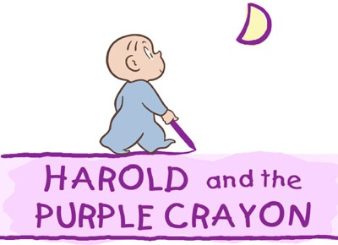

Slide 2
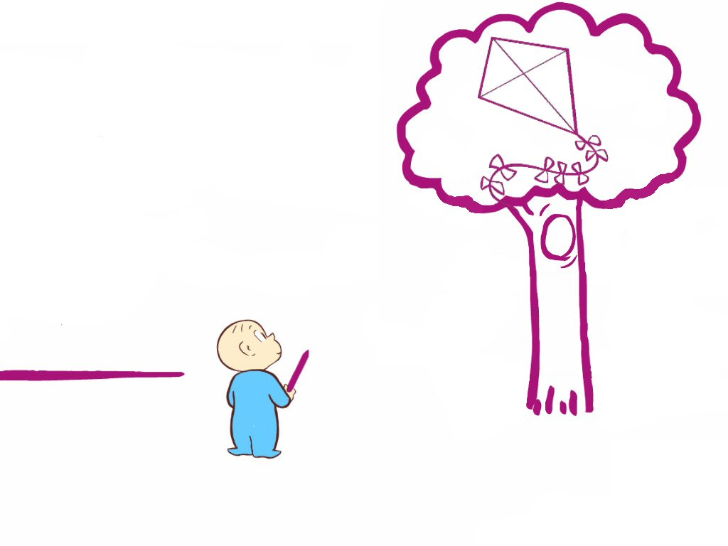

Slide 3
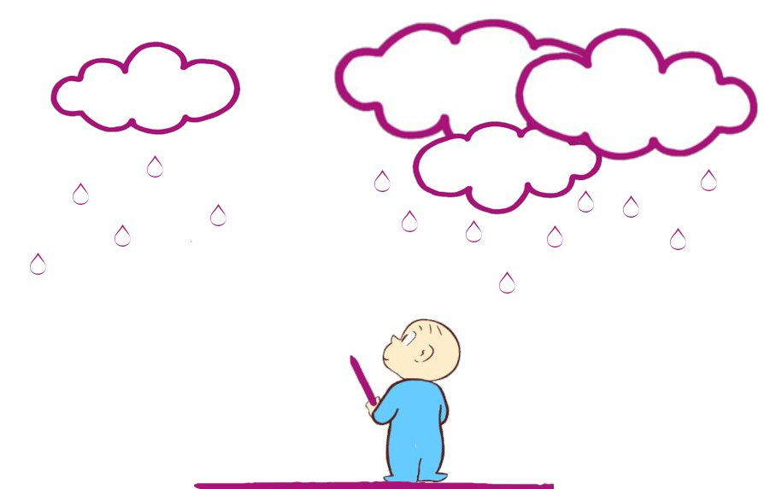

Slide 4
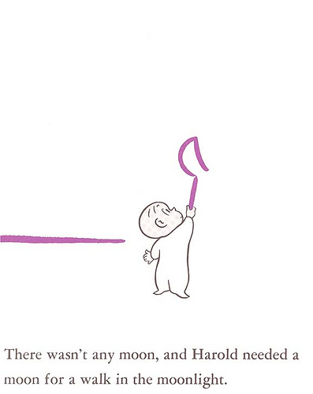
Moonlight:
the light of the moon

Slide 5
moon*light

Slide 6
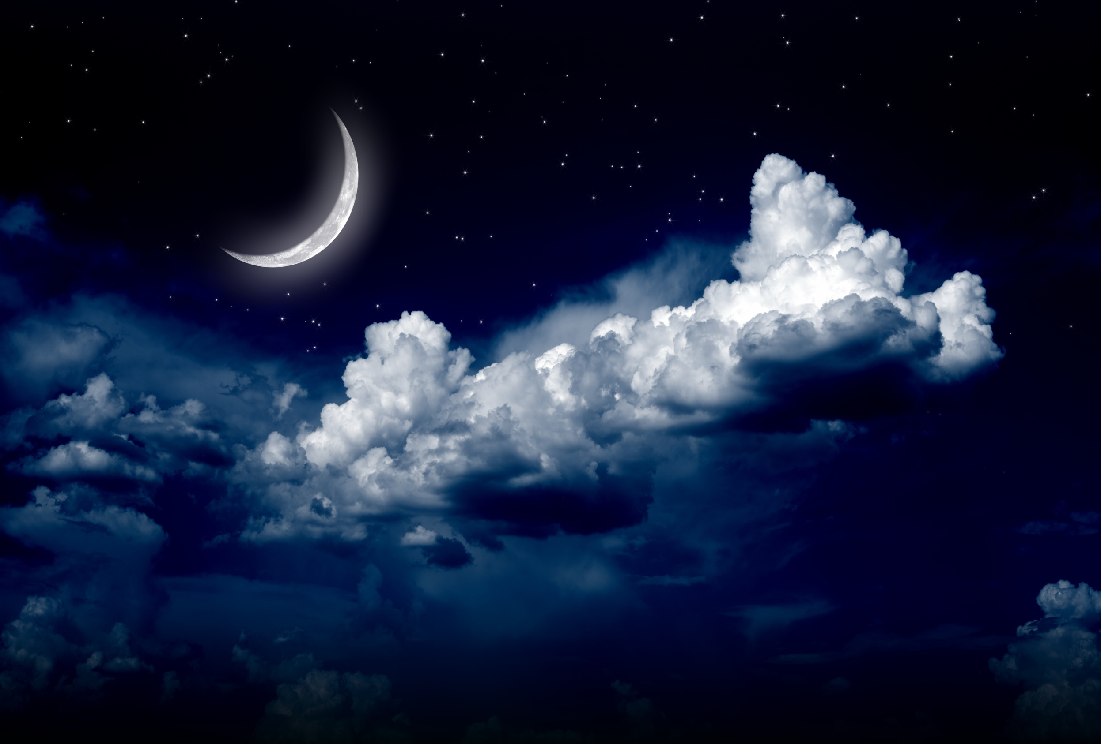
Moonlight

Slide 7
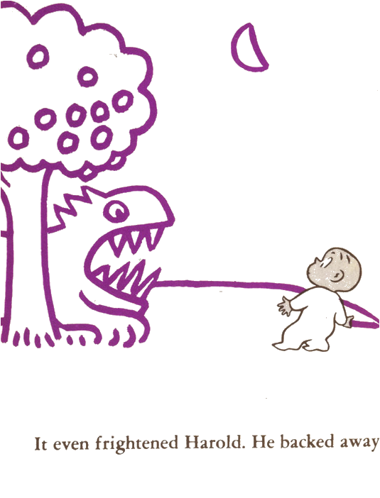
Frightening:
something that scares you

Slide 8
fright*en*ing

Slide 9
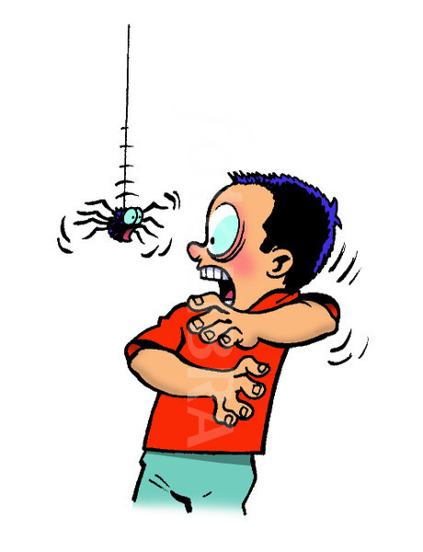
Frightening!

Slide 10
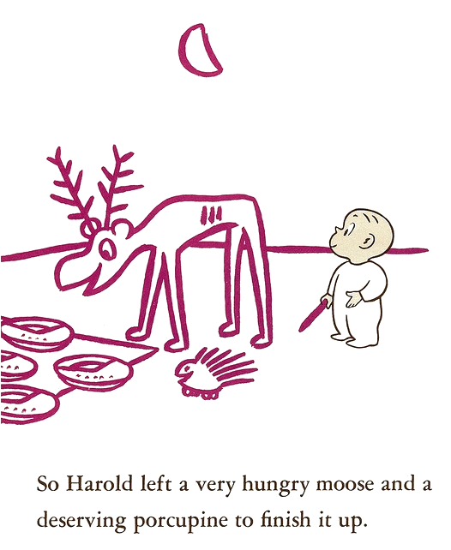
Deserving:
to be worthy of

Slide 11
des*erv*ing

Slide 12
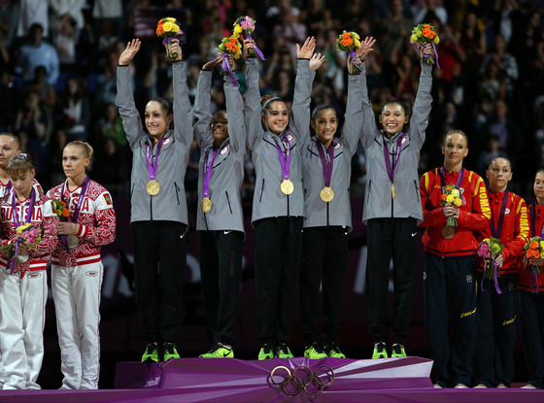
Deserving

